Slide 1
Difference between throw, throws and Throwable In Java
momedaram

Slide 2
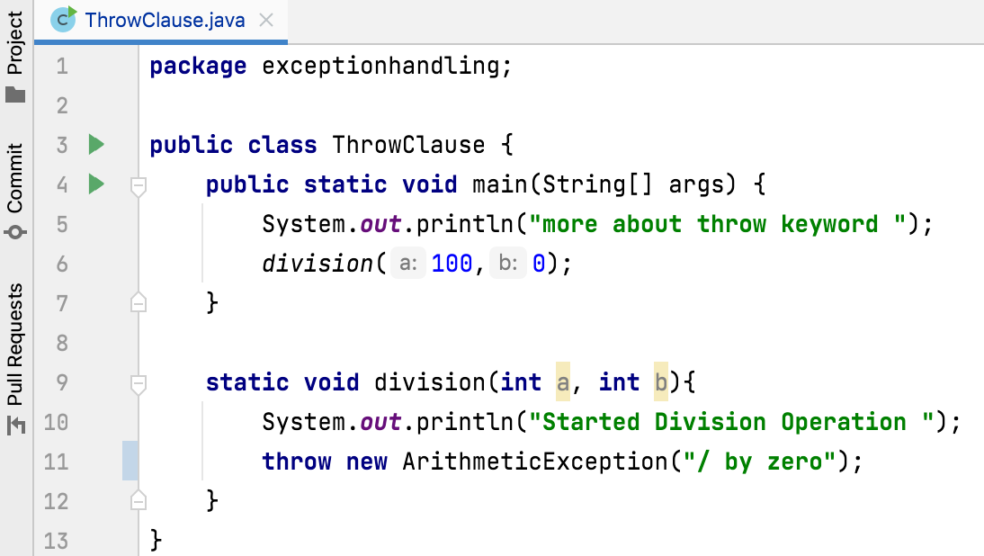
throw In Java :
throw is a keyword in java which is used to throw an exception manually.
We can throw an exception from any method or block, But that exception must be of type java.lang.Throwable class or it’s sub classes.

Slide 3
throws In Java :
throws is a keyword in java which is used in the method signature to indicate that the method may throw mentioned exceptions.
The caller methods must handle the mentioned exceptions either using try-catch blocks or using throws keyword.
Syntax:
return_type method_name(parameter_list) throws exception_list
{
// body
}

Slide 4
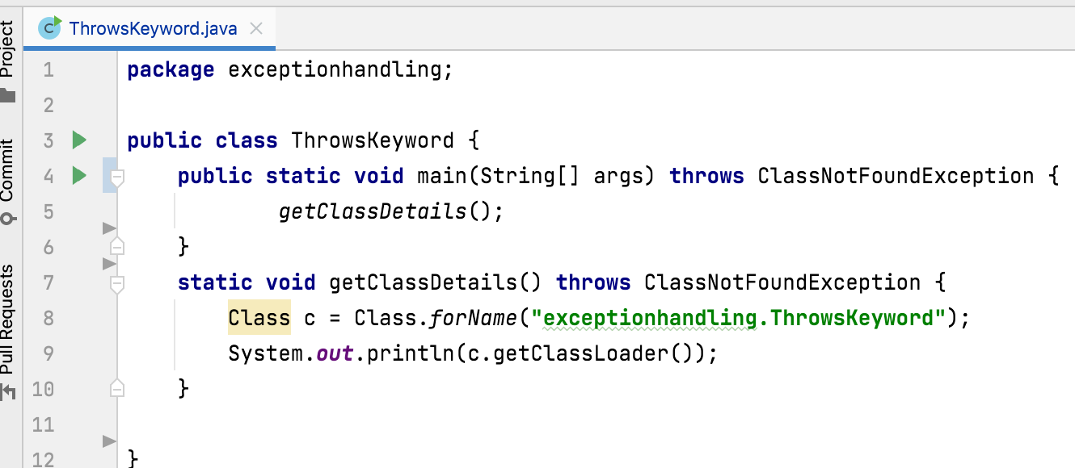
Handling with Throws

Slide 5
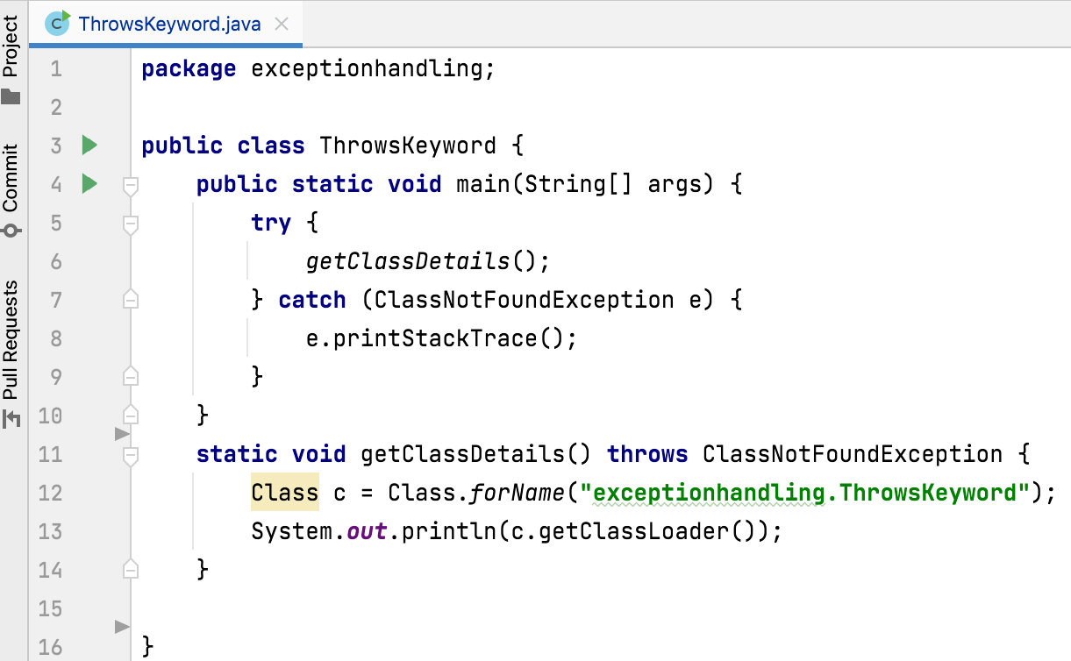
Handling with try-catch block

Slide 6
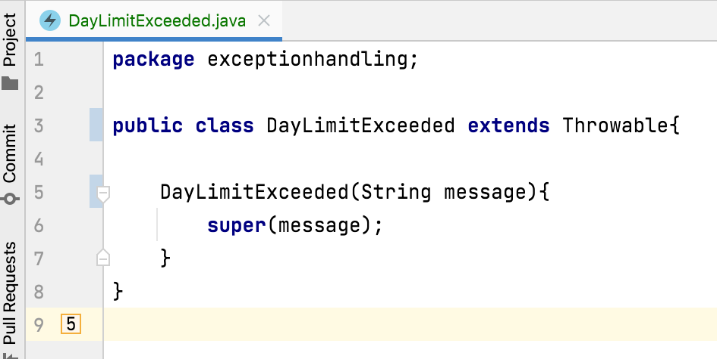
Throwable:
Java.lang.Throwable is a super class for all types of errors and exceptions in java.
Only instances of this class or its sub classes are thrown by the java virtual machine or by the throw statement.
The only argument of catch block must be of this type or it’s sub classes.
If you want to create your own customized exceptions, then your class must extend this class or its sub classes.

Slide 7

Thank You !
momedaram

